Slide 1
The Meaning of ‘Means’
Justin D’Ambrosio
University of St. Andrews

Slide 2

Three Questions
Too-Hard Box
1) What is meaning?
  Lots of discussion; many candidate views
  Difficulty level: high
  Not going to try to answer.
2) What does ‘means’ mean?
  Relatively overlooked; few candidate views
  Difficulty level: medium
  Hoping to answer
3) What follows from an answer to (2)?
  Basically unaddressed
  Difficulty level: medium
  Hoping to answer, and so shed light on (1).

Slide 3
Consider the following sentences*:
‘The woman who discovered radium’ means the woman who discovered radium.
‘Antelope’ means antelope.
‘Suddenly’ means suddenly.
‘Very athletic’ means very athletic.
‘Without a trace’ means without a trace.
‘Someone in the store’ means someone in the store.
‘To the Pyrenees or the Alps’ means to the Pyrenees or the Alps.
*There’s something grammatically amiss with these ‘sentences’. But what?

Slide 4
Kripke’s footnote on ‘means’:
I am not familiar with an accepted felicitous convention to indicate the object of the verb 'to mean’. There are two problems.
First, if one says, "By 'the woman who discovered radium' I meant the woman who discovered radium," the object can be interpreted in two ways. It may stand for a woman (Marie Curie), in which case the assertion is true only if ‘meant’ is used to mean referred to (as it can be used); or it may be used to denote the meaning of the quoted expression, not a woman, in which case the assertion is true with 'meant' used in the ordinary sense.
Second, as is illustrated by ‘referred to’, ‘green’, ‘quus’, etc. above, as objects of ‘meant’, one must use various expressions as objects in an awkward manner contrary to normal grammar. (Frege's difficulties concerning unsaturatedness are related.)
Kripke, WoRPL, p. 9
What are our options?

Slide 5
Option 1: mention
Proposal: Put the object in quotation marks.
Kripke:
Both problems tempt one to put the object in quotation marks, like the subject; but such a usage conflicts with the convention of philosophical logic that a quotation denotes the expression quoted. (ibid.)
Result:
  ‘Suddenly’ means ‘suddenly’
  ‘Without a trace’ means ‘without a trace’
Problem: wrong meaning!

Slide 6
Option 2: special ‘meaning marks’
Proposal: Put the object in special ‘meaning marks’, where meaning marks form a new expression that refers to the original expression’s meaning.
Kripke:
Some special 'meaning marks', as proposed for example by David Kaplan, could be useful here. (ibid.)
Result:
  ‘Suddenly’ means ^{m}suddenly^{m.}
  ‘Without a trace’ means ^{m}without a trace^{m}.
Problem? We’ll see!

Slide 7
Option 3: ordinary use.
Proposal: Do nothing to the object position.
Kripke:
I contemplated using italics ("'plus' means plus"; "'mean' may mean denote"), but I decided that normally […] I will write the object of ‘to mean’ as an ordinary roman object.
Result:
  ‘Suddenly’ means suddenly.
  ‘Without a trace’ means without a trace.
Problem: ungrammaticality. Or maybe even nonsense.

Slide 8
Grammaticality regained: italicization
‘The woman who discovered radium’ means the woman who discovered radium.
‘Antelope’ means antelope.
‘Suddenly’ means suddenly.
‘Very athletic’ means very athletic.
‘Without a trace’ means without a trace.
‘Someone in the store’ means someone in the store.
‘To the Pyrenees or the Alps’ means to the Pyrenees or the Alps.
‘The woman who discovered radium’ means the woman who discovered radium.
‘Antelope’ means antelope.
‘Suddenly’ means suddenly.
‘Very athletic’ means very athletic.
‘Without a trace’ means without a trace.
‘Someone in the store’ means someone in the store.
‘To the Pyrenees or the Alps’ means to the Pyrenees or the Alps.
But what does italicization do?
And what do these sentences mean?

Slide 9
Goal of this talk, pt. 1: a new view of the meaning of ‘means’
Offer a novel semantics for ‘means’ and an account of how italicization functions in its complement.
What italicization is not:
quotation—the italicized complement doesn’t refer to an expression!
meaning marks—the italicized complement doesn’t refer to a meaning!
Italicization doesn’t create referring expression at all.
What italicization is:
A way of ‘shifting’ the type of means so that it can combine with the type of the expression that occurs in its complement. Strictly speaking, italicization indicates type passing.
A way of allowing ‘means’ to accept expressions of any grammatical category in its complement.
  This is what I call the ‘type polymorphism’ view.

Slide 10
Goal of this talk, pt. 2: Consequences for semantics
Use this semantics to argue for one approach to the semantics of natural (and logical) languages and against another.
Approach 1: the first-order, ‘model-theoretic’ approach (the traditional approach in semantics).
  Interprets every expression by pairing it with an object in a model.
  Names denote objects, other parts of speech denote functions.
Approach 2: the higher-order, ‘type-theoretic’ approach (associated with higher-order metaphysics).
  Interprets expressions using a higher-order interpretation function.
  Semantic values are not sets; interpretation is carried out in a language we already understand.
Argue for two claims:
The H-O approach can and should state their theory of meaning using the verb ‘means.’
Only the HO-approach can state their theory of meaning using the verb ‘means.’
Conclusion: Only the HO-approach can offer a theory of meaning.

Slide 11
Kripkean Awkwardness

Slide 12
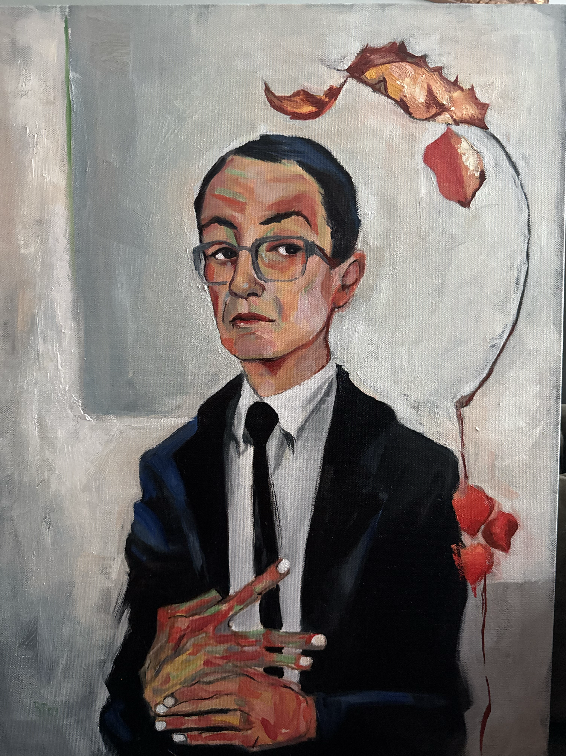
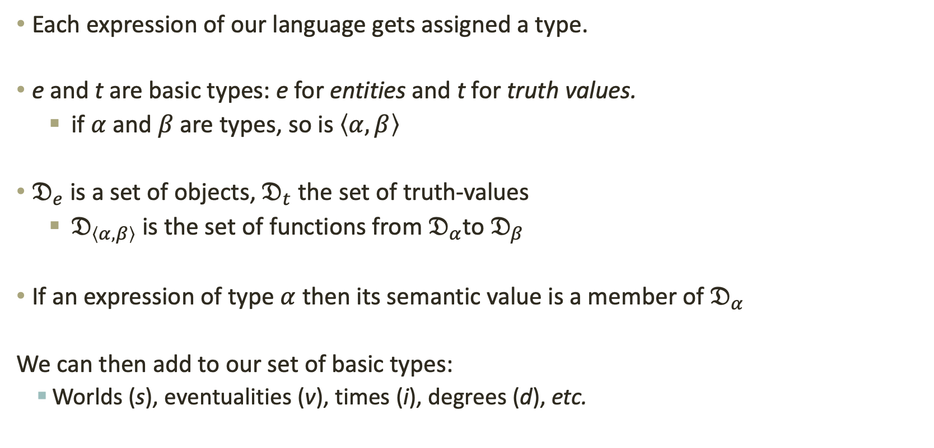
Basics of type theory
Each expression of our language gets assigned a type.
e and t are basic types: e for entities and t for truth values.
if $α$ and $β$ are types, so is $\left\langle α,β\right\rangle$
$𝔇_{e}$ is a set of objects, $𝔇_{t}$ the set of truth-values
$𝔇_{\left\langle α,β\right\rangle }$ is the set of functions from $𝔇_{α}$to $𝔇_{β}$
If an expression of type $α$ then its semantic value is a member of $𝔇_{α}$
We can then add to our set of basic types:
  Worlds (s), eventualities (v), times (i), degrees (d), etc.
Image: “Montague in the style of Egon Schiele”
by Renée Jorgensen.

Slide 13
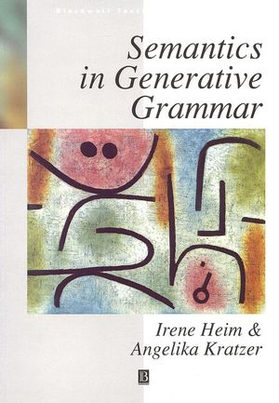
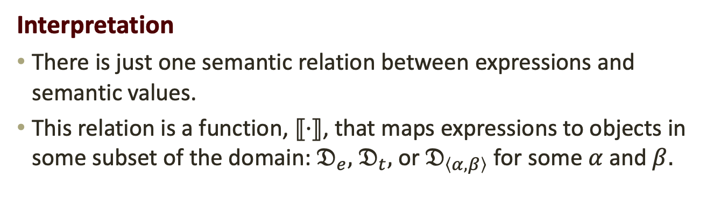
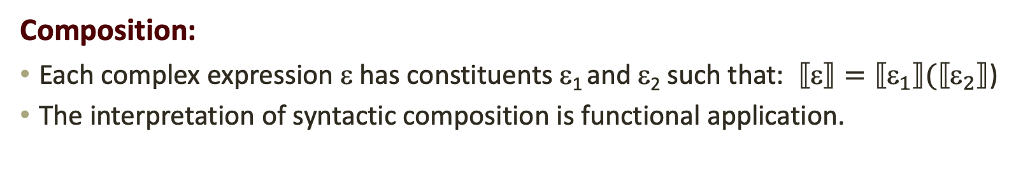
Standard Assumptions in Type Theory
Interpretation
There is just one semantic relation between expressions and semantic values.
This relation is a function, $⟦·⟧$, that maps expressions to objects in some subset of the domain: $𝔇_{e},$ $𝔇_{t},$ or $𝔇_{\left\langle α,β\right\rangle }$ for some $α$ and $β.$
Composition:
Each complex expression ε has constituents ε₁ and ε₂ such that: $⟦⟧=⟦_{1}⟧(⟦_{2}⟧$)
The interpretation of syntactic composition is functional application.

Slide 14
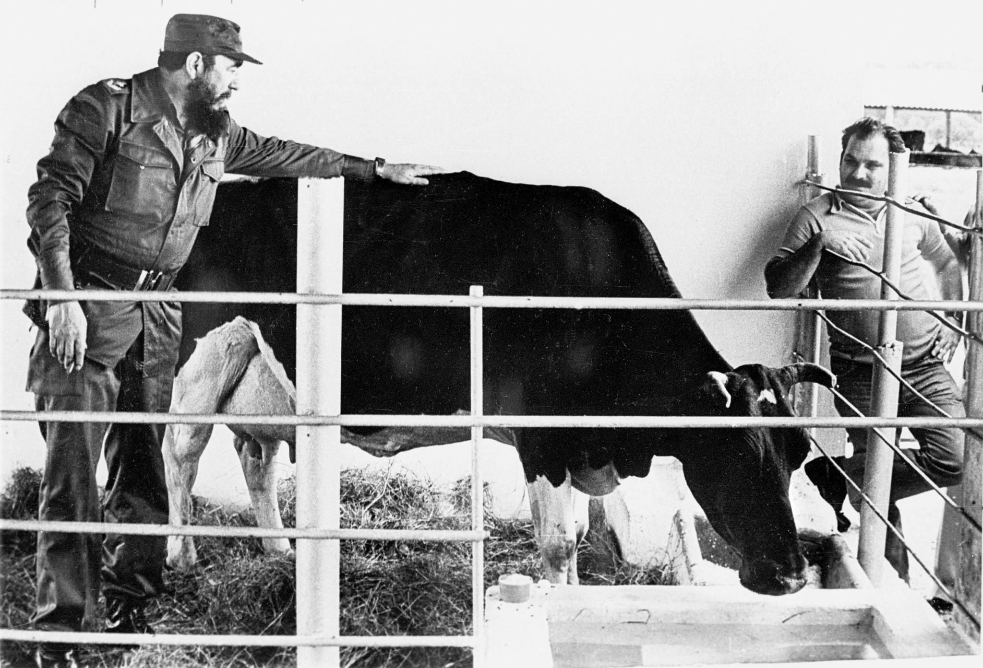
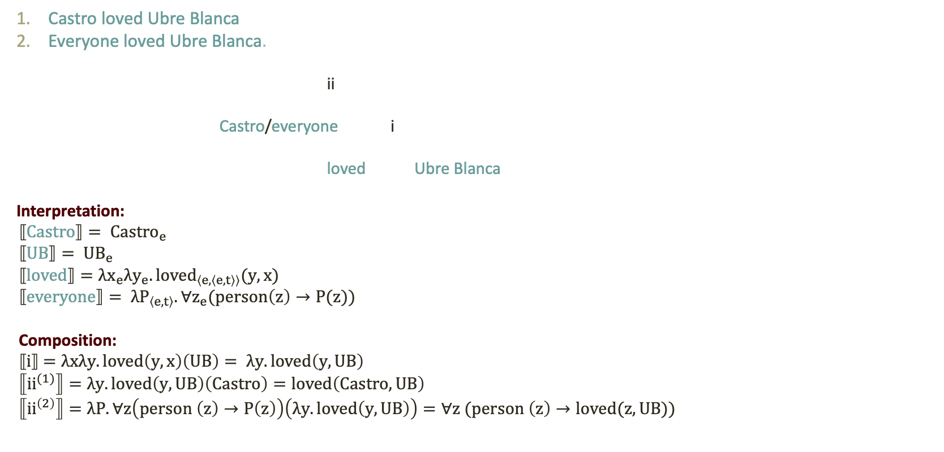
An illustration: Castro’s favourite cow
Castro loved Ubre Blanca
Everyone loved Ubre Blanca.
ii
Castro/everyone i
loved Ubre Blanca
Interpretation:
$$⟦Castro⟧= {Castro}_{e}$$
$⟦UB⟧= {UB}_{e}$
$⟦loved⟧=λx_{e}λy_{e}.{loved}_{〈e,〈e,t〉〉}(y,x)$
$$⟦everyone⟧= λP_{〈e,t〉}.\text{∀}z_{e}(person\left(z\right)→P(z))$$
Composition:
$⟦i⟧$ $=λxλy.loved\left(y,x\right)\left(UB\right)= λy.loved\left(y,UB\right)$
$$⟦{ii}^{(1)}⟧=λy.loved\left(y,UB\right)\left(Castro\right)=loved\left(Castro, UB\right)$$
$$⟦{ii}^{\left(2\right)}⟧=λP.\text{∀}z\left(person \left(z\right)→P\left(z\right)\right)\left(λy.loved\left(y,UB\right)\right)=\text{∀}z (person \left(z\right)→loved(z, UB))$$

Slide 15
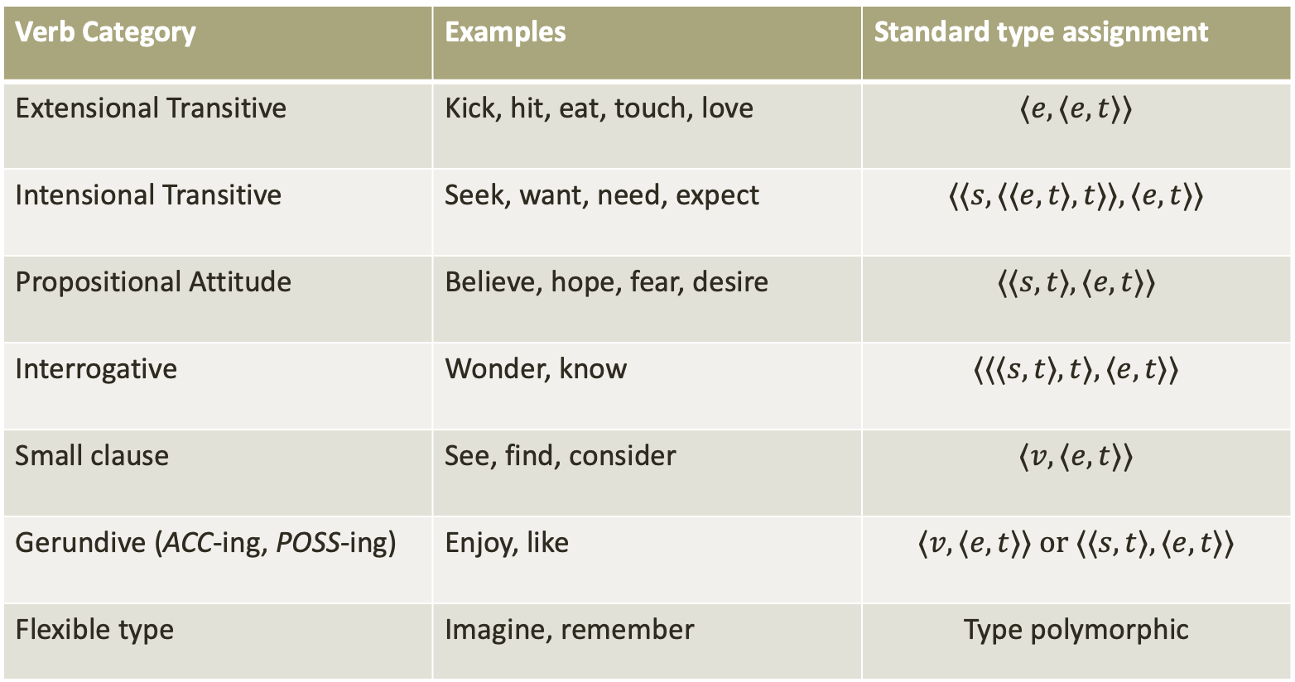
Types of verbs and their complements
Verb Category | Examples | Standard type assignment
Extensional Transitive | Kick, hit, eat, touch, love | $$⟨e,⟨e,t⟩⟩$$
Intensional Transitive | Seek, want, need, expect | $$⟨⟨s,⟨⟨e,t⟩,t⟩⟩, ⟨e,t⟩⟩$$
Propositional Attitude | Believe, hope, fear, desire | $$⟨⟨s,t⟩, ⟨e,t⟩⟩$$
Interrogative | Wonder, know | $$⟨⟨⟨s,t⟩,t⟩, ⟨e,t⟩⟩$$
Small clause | See, find, consider | $$⟨v,⟨e,t⟩⟩$$
Gerundive (ACC-ing, POSS-ing) | Enjoy, like | $$⟨v,⟨e,t⟩⟩ or ⟨⟨s,t⟩, ⟨e,t⟩⟩$$
Flexible type | Imagine, remember | Type polymorphic
Kick, hit, eat, touch, see(?),
Seek, want, need,
Believe, desire, hope,
Intend, desire, hope
Imagine, remember

Slide 16

Type flexibility: ‘Imagine’
‘Imagine’ exhibits more selectional flexibility in its complement than basically any other verb.
    Mary imagined Bill.
    Mary imagined a unicorn.
    Mary imagined that she was flying.
    Mary imagined what flying is like.
    Mary imagined flying away.
    Mary imagined Bill flying.
    Mary imagined a woman’s flying.

Slide 17

In ordinary usage, ‘means’ is not very flexible.
Example | Complement | Type
This means that we won’t have to waste any good wine. | That-clause | ⟨s,t⟩
The painting means a lot to JoAnn. | Measure phrase | ⟨⟨d,t⟩,t⟩
This means trouble for Mary’s finances. | Bare nominal | e
Your words mean nothing to me. | Special quantifier | Type polymorphic
J

Slide 18
The need for flexibility
We want to use ‘means’ to specify the meaning of every expression of our language, because the following schema is extremely compelling:
Means-Disquotation: For all expressions, Φ, ⌜Φ⌝ means Φ.
Means-Disquotation seems to entail that ‘means’ can accept complements of any type, because Φ itself can be of any type.
This seems to require that ‘means’ is not only type polymorphic, but in infinitely flexible.
Caveat: Bacon and Goodman (2021) argue that there is at least one instance of Means-Disquotation that we should not accept.

Slide 19

Explaining Kripkean Awkwardness
Question: why do we have to use the expressions in the complement of ‘means’ in an awkward way?
Answer: ‘Means’ only natively accepts complements of certain types, but in specifying the meanings of expressions, it is being asked to accept complements of any type.
This occasions a grammatical or type clash, which leads to awkwardness.
Kripke claims that this has to do with ‘Frege’s problem of unsaturatedness’—we’ll see why momentarily.

Slide 20
Resolving Kripkean Awkwardness

Slide 21
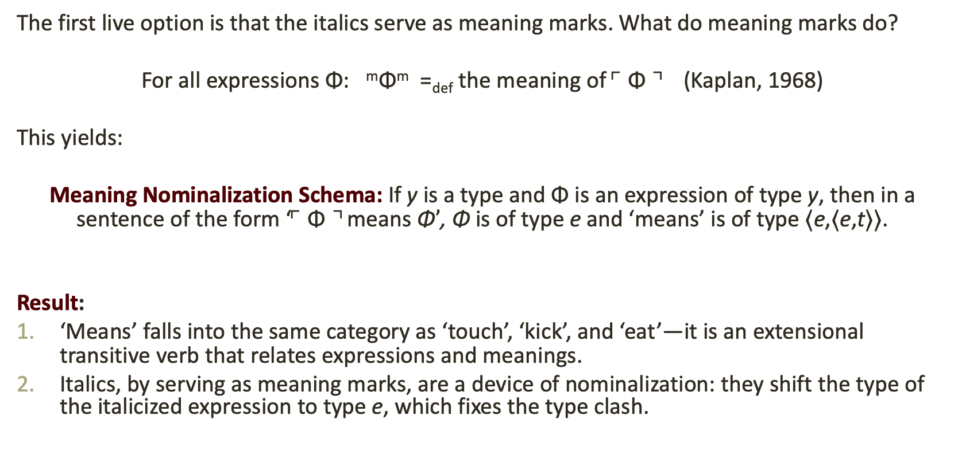
Option 1: Meaning Marks
The first live option is that the italics serve as meaning marks. What do meaning marks do?
For all expressions Φ: ^{m}Φ^{m} =_{def} the meaning of ⌜Φ⌝ (Kaplan, 1968)
This yields:
Meaning Nominalization Schema: If y is a type and Φ is an expression of type y, then in a sentence of the form ‘⌜Φ⌝ means Φ$’$, Φ is of type e and ‘means’ is of type ⟨e,⟨e,t⟩⟩.
Result:
‘Means’ falls into the same category as ‘touch’, ‘kick’, and ‘eat’—it is an extensional transitive verb that relates expressions and meanings.
Italics, by serving as meaning marks, are a device of nominalization: they shift the type of the italicized expression to type e, which fixes the type clash.

Slide 22
Frege’s problem of unsaturatedness
Recall Kripke:
  … as objects of ‘meant’, one must use various expressions as objects in an awkward manner contrary to normal grammar. (Frege's difficulties concerning unsaturatedness are related.)
Frege’s difficulties concerning unsaturatedness come from attempts to use a name or some other referring expression to pick out the semantic values of a different type.
Examples:
  ‘The concept horse’
  ‘The proposition that Fido bites’
  ‘Logicism’
  ‘The question of who to trust’
Kripke’s View: ‘Means’ accepts only names in its object position—expressions of type e—which forces us to use a name to pick out the meanings of expressions of all types.

Slide 23
First problem for the meaning-mark view: Prior’s puzzle
Consider the following argument:
Mary fears that the earth will explode. (premise)
‘That the earth will explode’ means ^{m}that the earth will explode^{m} (meaning-marks proposal)
^{m}that the earth will explode^{m} =_{def} the meaning of ‘that the earth will explode’ (definition of meaning marks)
Mary fears the meaning of ‘that the earth will explode.’ (substitution of synonyms)
But (4) is clearly false!

Slide 24
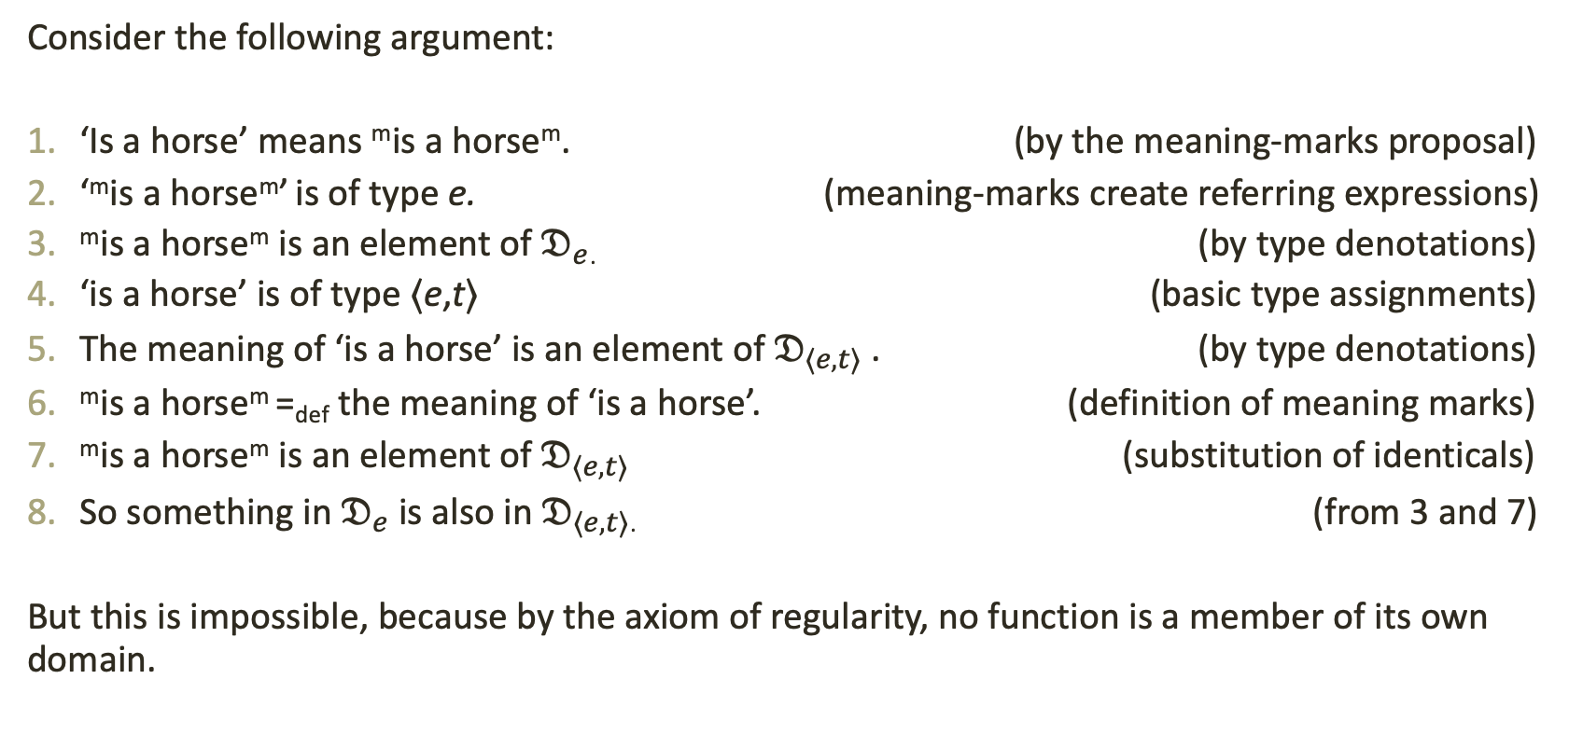
Second problem for the meaning-mark view: the concept horse.
Consider the following argument:
‘Is a horse’ means ^{m}is a horse^{m}. (by the meaning-marks proposal)
‘^{m}is a horse^{m}’ is of type e. (meaning-marks create referring expressions)
^{m}is a horse^{m} is an element of $𝔇_{e}$. (by type denotations)
‘is a horse’ is of type ⟨e,t⟩ (basic type assignments)
The meaning of ‘is a horse’ is an element of $𝔇_{⟨e,t⟩}$ . (by type denotations)
^{m}is a horse^{m} =_{def} the meaning of ‘is a horse’. (definition of meaning marks)
^{m}is a horse^{m} is an element of $𝔇_{⟨e,t⟩}$ (substitution of identicals)
So something in $𝔇_{e}$ is also in $𝔇_{⟨e,t⟩}$. (from 3 and 7)
But this is impossible, because by the axiom of regularity, no function is a member of its own domain.

Slide 25

Option 2: Type Polymorphism
The second live option is that italicization shifts the type of ‘means’ so that the type of its complement matches the type of the expression it takes in subject position.
‘Means’ Polymorphism Schema: If y is a type and Φ is an expression of type y, then in a sentence of the form ‘⌜Φ⌝ means Φ’, Φ is of type y and ‘means’ is of type ⟨y,⟨e,t⟩⟩.
Result:
The expression in the complement of ‘means’ retains its ordinary type.
Italicization shifts the type of ‘means’ so that it accepts this type. This fixes the type clash.

Slide 26

Use rather than mention
This view is actually intuitive. Consider (PA):
(PA) ‘To the Pyrenees or the Alps’ means to the Pyrenees or the Alps.
Intuitively, the stress or italicization allow us to use the expression in the object position in the ordinary way.
We aren’t quoting the expression, we aren’t naming it’s meaning, and it isn’t being used awkwardly. Italicization preserves its type.
What is being used awkwardly is ‘means’ itself!

Slide 27
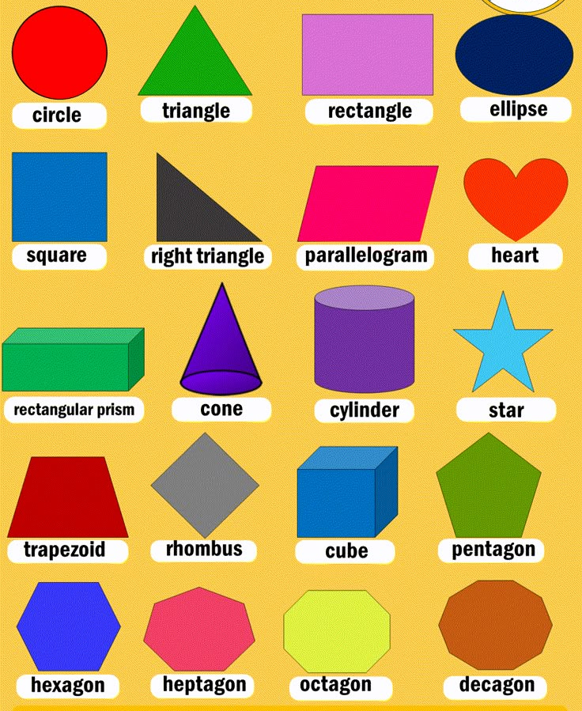
We need type polymorphism anyway
Standard type theory assigns every expression a unique type. But lots of expressions take many types of arguments—they exhibit type flexibility.
Examples:
  Generalized identity
  Generalized conjunction, disjunction, and negation
  Flexibly typed attitude verbs like ‘imagine’.
  Special quantifiers like ‘something’
Possibility 1 (worse): have a different lexical entry for each different type of argument.
Possibility 2 (better): have one flexible, ‘polymorphic’ lexical denotation.

Slide 28
A semantics for ‘means’

Slide 29
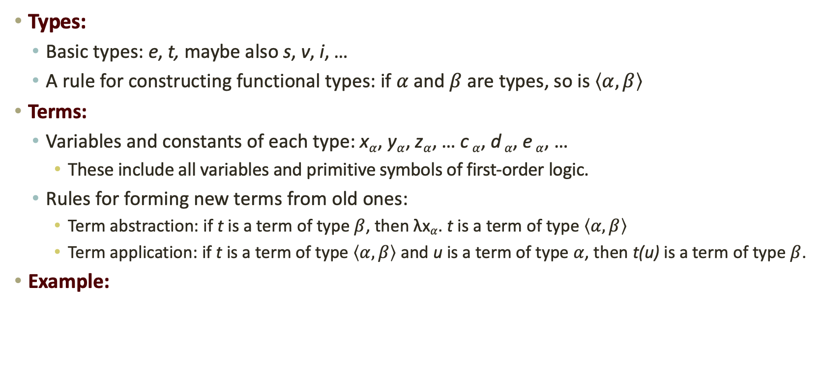
Reminder: Standard Type Theory
Types:
  Basic types: e, t, maybe also s, v, i, …
  A rule for constructing functional types: if $α$ and $β$ are types, so is $\left\langle α,β\right\rangle$
Terms:
  Variables and constants of each type: x$α$, y$α$, z$α$, … c $α$, d $α$, e $α$, …
    These include all variables and primitive symbols of first-order logic.
  Rules for forming new terms from old ones:
    Term abstraction: if t is a term of type $β$, then λx$α$. t is a term of type $\left\langle α,β\right\rangle$
    Term application: if t is a term of type $\left\langle α,β\right\rangle$ and u is a term of type $α$, then t(u) is a term of type $β$.
Example:

Slide 30
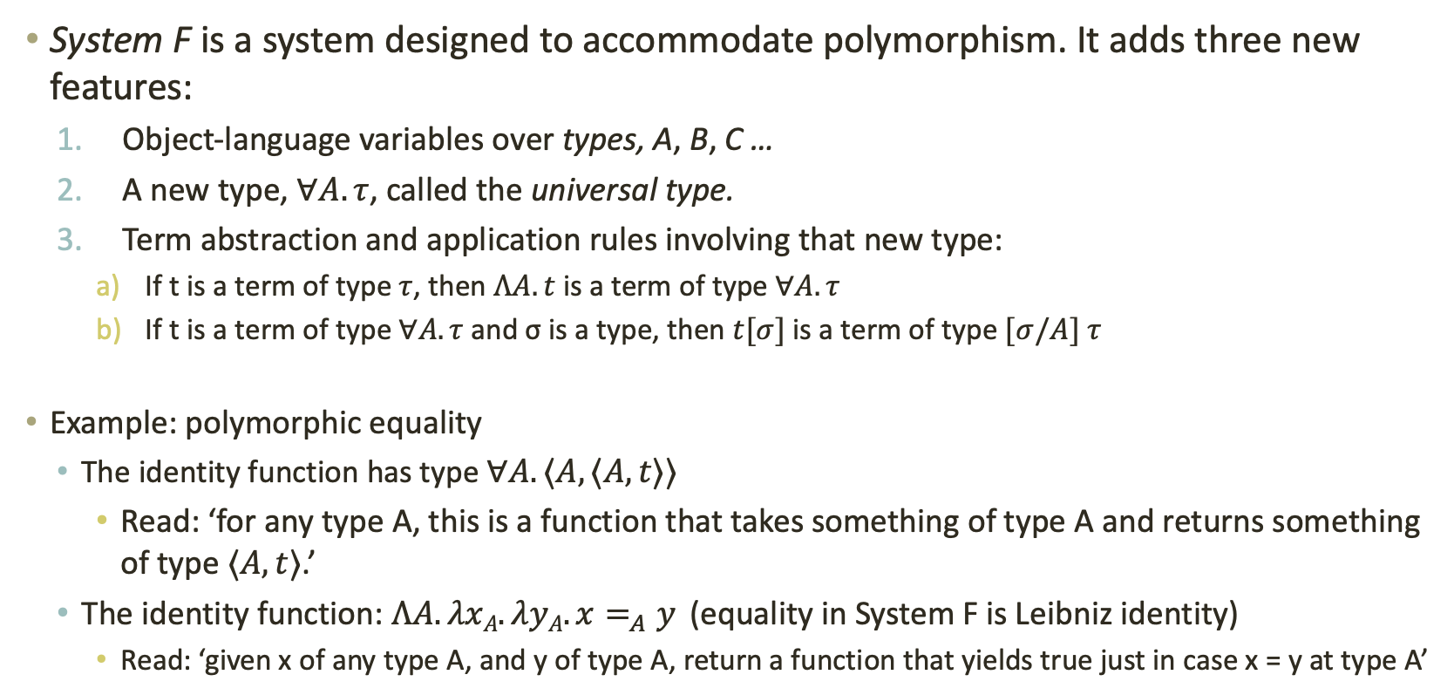
Polymorphic Type Theory: System F
System F is a system designed to accommodate polymorphism. It adds three new features:
  Object-language variables over types, A, B, C …
  A new type, $∀A. τ$, called the universal type.
  Term abstraction and application rules involving that new type:
    If t is a term of type $τ$, then $ΛA. t$is a term of type $∀A. τ$
    If t is a term of type $∀A. τ$and σ is a type, then $t[σ]$is a term of type $[σ/A] τ$
Example: polymorphic equality
  The identity function has type $∀A. ⟨A, ⟨A,t⟩⟩$
    Read: ‘for any type A, this is a function that takes something of type A and returns something of type $⟨A,t⟩$.’
  The identity function: $ΛA. λxA.λyA.x=_{A}y$ (equality in System F is Leibniz identity)
    Read: ‘given x of any type A, and y of type A, return a function that yields true just in case x = y at type A’

Slide 31


A semantics for ‘means’ in System F
I’ve claimed that ‘means’ is type polymorphic in its second argument
position. This makes ‘means’ a constant of type: $∀A.⟨A,⟨e,t⟩⟩$
  Example: ‘Very athletic’ means very athletic.
Interpretation:
⟦$very athletic⟧$ =$λxe.veryathletic$_{⟨e,t⟩}$(x)$
⟦$‘very athletic’⟧$ = $‘very athletic’e$
⟦$means⟧$= $ΛA.λxA .λye.MEANS[A](y,x).$
Type preservation
Composition:
Notes:
Here we interpret the italicized phrase very athletic with its ordinary type.
Italicization is hypothesized mark how the type is passed to ‘means’.
Italicization
marks type passing

Slide 32
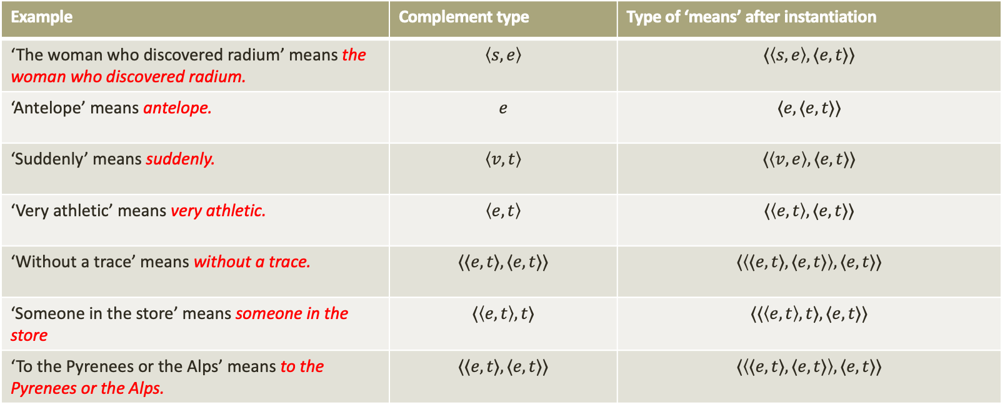
A single meaning for many relations
System F allows ‘means’ to have one flexible type that accommodates the type of its complement.
If the complement has type $τ$, then we can instantiate the universal type with type $τ$, which yields the appropriate, more specific type of ‘means’.
Example | Complement type | Type of ‘means’ after instantiation
‘The woman who discovered radium’ means the woman who discovered radium. | $$\left\langle s,e\right\rangle$$ | $$⟨\left\langle s,e\right\rangle ,⟨e,t⟩⟩$$
‘Antelope’ means antelope. | $$e$$ | $$⟨e,⟨e,t⟩⟩$$
‘Suddenly’ means suddenly. | $$\left\langle v,t\right\rangle$$ | $$⟨\left\langle v,e\right\rangle ,⟨e,t⟩⟩$$
‘Very athletic’ means very athletic. | $$\left\langle e,t\right\rangle$$ | $$⟨\left\langle e,t\right\rangle ,⟨e,t⟩⟩$$
‘Without a trace’ means without a trace. | $$⟨⟨e,t⟩,⟨e,t⟩⟩$$ | $$⟨\left\langle ⟨e,t⟩,⟨e,t⟩\right\rangle ,⟨e,t⟩⟩$$
‘Someone in the store’ means someone in the store | $$⟨\left\langle e,t\right\rangle ,t⟩$$ | $$⟨⟨\left\langle e,t\right\rangle ,t⟩,⟨e,t⟩⟩$$
‘To the Pyrenees or the Alps’ means to the Pyrenees or the Alps. | $$⟨⟨e,t⟩,⟨e,t⟩⟩$$ | $$⟨\left\langle ⟨e,t⟩,⟨e,t⟩\right\rangle ,⟨e,t⟩⟩$$

Slide 33
Taking Stock
What we’ve done so far:
Introduced the problem: Kripkean awkwardness.
Offered a diagnosis: awkwardness results from a type clash within the complement of means.
Provided notational fix: italicization.
Offered an interpretation of italicization: italicization shifts the type of ‘means’.
Developed a semantics: ‘means’ is type polymorphic in its second argument place.
Things we still need to do:
Show that the type-polymorphism view succeeds where the meaning-marks view fails.
Show that ‘means’ can be used to interpret the object-language.

Slide 34

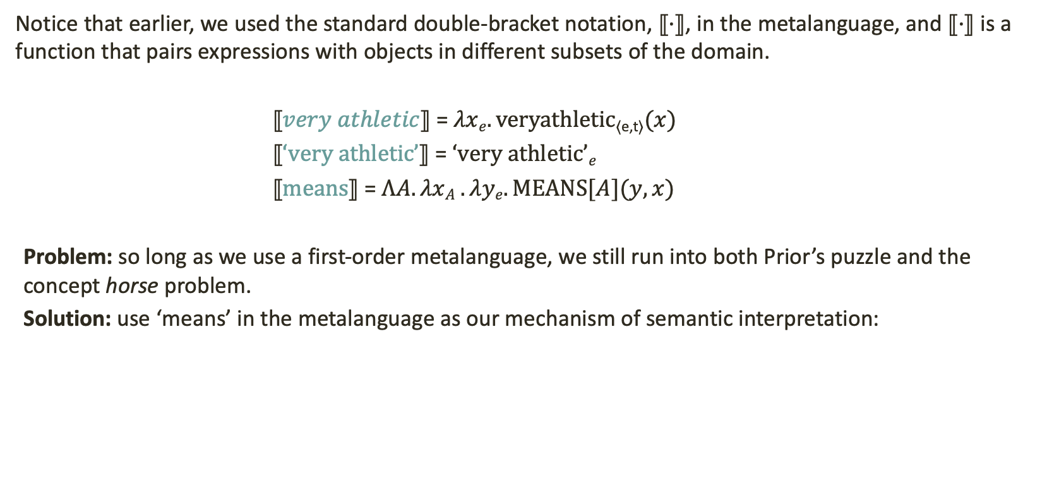
‘Means’ as metalanguage
Notice that earlier, we used the standard double-bracket notation, $⟦·⟧$, in the metalanguage, and $⟦·⟧$ is a function that pairs expressions with objects in different subsets of the domain.
⟦$very athletic⟧$ =$λxe.veryathletic$_{⟨e,t⟩}$(x)$
⟦$‘very athletic’⟧$ = $‘very athletic’e$
⟦$means⟧$= $ΛA.λxA .λye.MEANS[A](y,x)$
Problem: so long as we use a first-order metalanguage, we still run into both Prior’s puzzle and the concept horse problem.
Solution: use ‘means’ in the metalanguage as our mechanism of semantic interpretation:
Means($very athletic,λxe.veryathletic$_{⟨e,t⟩}$(x))$
Means($‘very athletic’,‘very athletic’e$)
Means($means,ΛA.λxA .λye.MEANS[A](y,x))$

Slide 35
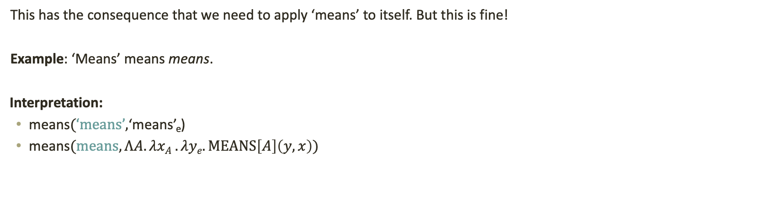
‘Means’ means means
This has the consequence that we need to apply ‘means’ to itself. But this is fine!
Example: ‘Means’ means means.
Interpretation:
means$(‘means’,$‘means’_{e})
means$(means,ΛA.λxA .λye.MEANS\left[A\right]\left(y,x\right))$
Composition:
Caveat: this makes System F impredicative

Slide 36
Two Approaches to
Semantic Theory

Slide 37
Two approaches to semantics: A comparison
First order, model-theoretic approach
(Tarski, Montague, Partee, Cresswell, Heim and Kratzer)
Higher order, type-theoretic approach
(Rayo and Yablo, Williamson, Uzquiano, Bacon, Krämer)
The traditional approach to the semantics of both natural and logical languages.
Interprets the object language in a first-order, set-theoretic metalanguage.
Employs a set as a domain; quantification is restricted to elements in that set.
Treats higher-order quantification as ‘many-sorted’ first-order quantification.
The semantic view underlying the program of ‘higher-order metaphysics’.
Interprets the object language in a higher-order metalanguage.
No set as a domain, which allows for absolutely general quantification.
Treats higher-order quantification as irreducible to first-order quantification.

Slide 38
Two higher-order approaches to interpretation
Williamson’s Polymorphic Approach
Krämer’s Hierarchy of Denotation Functions
Williamson employs a higher-order expression in the metalanguage, a_{⟨⟨e,y⟩,t⟩}, that serves to interpret every expression of the object language.
Here, y is what Williamson calls the ‘limit type’—the union of all finite types.
Any expression that has limit type y also has some finite type t—y is instantiated with a more specific type.
The limit type is effectively System F’s universal type.
Krämer employs a family of different denotation functions, one for each type.
  ∀i∀n den^{i}₁(n) =₁ i(n)
  ∀I∀P den^{i}₂(P) =₂ I(P)
  …
  ∀i∀c den^{i}_{n}(n) =_{n} i(n)
Roughly, these are the instances of Williamson’s polymorphic interpretation relation a_{⟨⟨e,y⟩,t⟩}.
Each of Krämer’s functions can be mapped to an instantiation of ‘means’ at particular type.

Slide 39
Disquotation and adequacy
The T-schema as condition of adequacy:
‘Bill went to the store’ is true if and only if Bill went to the store.
‘Snow is white’ is true if and only if snow is white.
T-schema: ⌜Φ⌝ is true iff Φ, for all well-formed sentences Φ of our language.
The meaning schema as condition of adequacy:
‘Bill went to the store’ means Bill went to the store.
‘Snow is white’ means snow is white.
Meaning schema: ⌜Φ⌝ means Φ, for all well-formed expressions Φ of our language.

Slide 40
Higher-order approaches can use ‘means’
Claim: Williamson and Krämer’s approaches to interpretation can both be stated in terms of ‘means’ without any loss.
Note the role that the interpretation expression plays for Williamson:
  One and the same expression serves to interpret every expression, of every semantic category, in the object language.
  The expression is type polymorphic in its second argument position.
  The expression is higher-order in its second argument position, and its semantics is not given in a first-order, set-theoretic metalanguage
  The expression validates the disquotation schema for all types.
  On the semantics I’ve offered, ‘means’ has all of these features.
  ‘Means’ is actually an improvement on Kramer’s view, because it allows one expression to perform all of these functions.

Slide 41
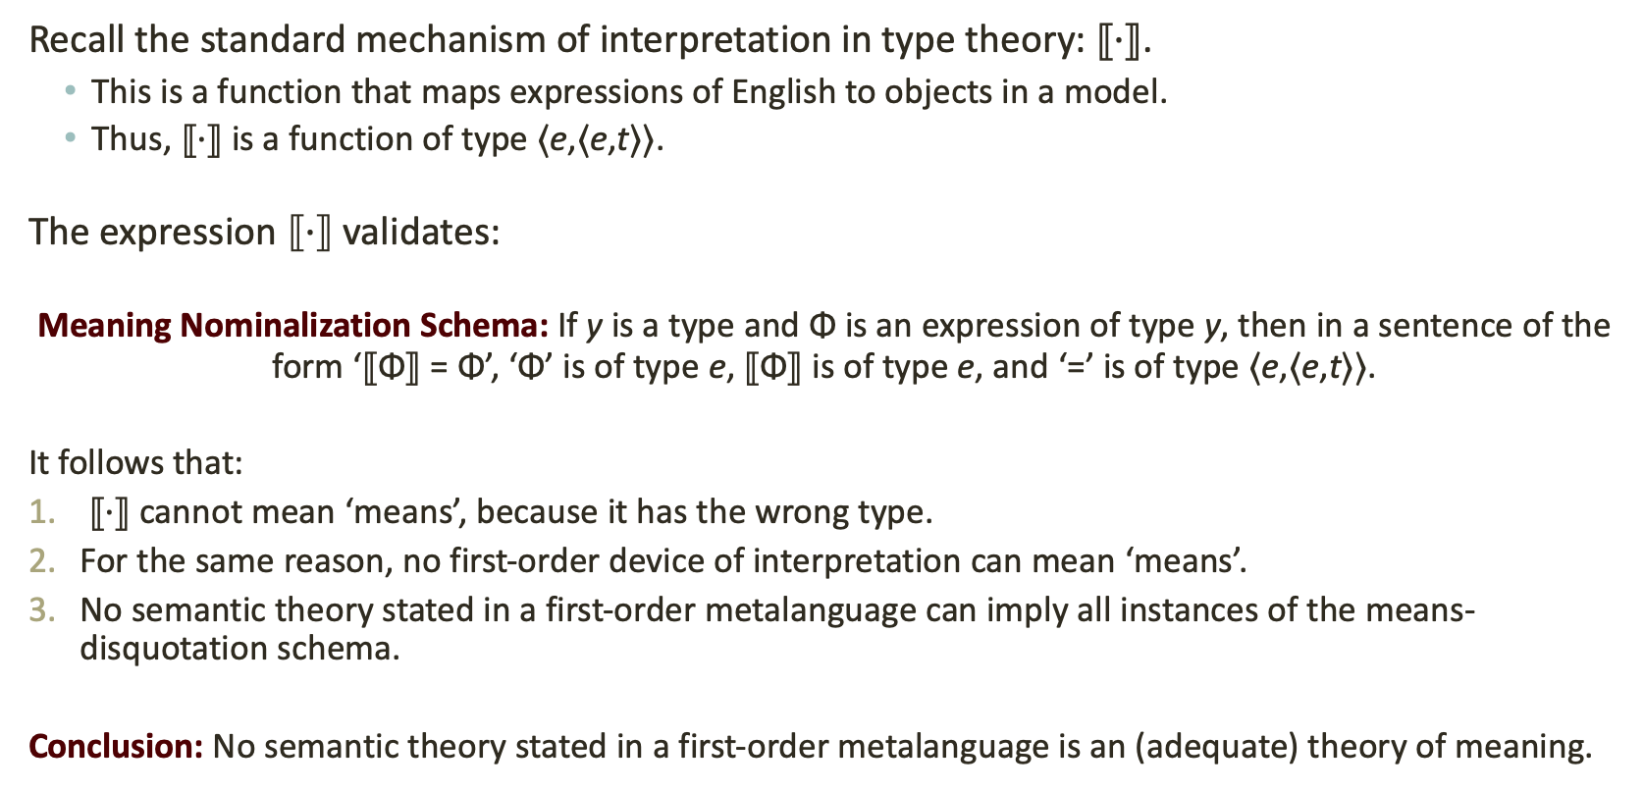
The model-theoretic approach cannot use ‘means’
Recall the standard mechanism of interpretation in type theory: $⟦·⟧$.
  This is a function that maps expressions of English to objects in a model.
  Thus, $⟦·⟧$ is a function of type ⟨e,⟨e,t⟩⟩.
The expression $⟦·⟧$ validates:
Meaning Nominalization Schema: If y is a type and Φ is an expression of type y, then in a sentence of the form ‘⟦Φ⟧ = Φ’, ‘Φ’ is of type e, ⟦Φ⟧ is of type e, and ‘=’ is of type ⟨e,⟨e,t⟩⟩.
It follows that:
$⟦·⟧$ cannot mean ‘means’, because it has the wrong type.
For the same reason, no first-order device of interpretation can mean ‘means’.
No semantic theory stated in a first-order metalanguage can imply all instances of the means-disquotation schema.
Conclusion: No semantic theory stated in a first-order metalanguage is an (adequate) theory of meaning.

Slide 42
Treating models as models
Question: What is the relationship between the type-theoretic, higher-order approach to meaning and the first-order, model-theoretic approach?
  The facts:
  These approaches are systematically related: ‘means’ and ⟦·⟧ are related, in that the latter just is the nominal counterpart of the former.
  The meaning of each expression is systematically related to its denotation in a model by means of nominalization.
  Nominalization has its costs, but it also has its benefits. It allows us to:
    Offer precise definitions of logical truth and logical consequence for first- and higher-order languages;
    Provide completeness and consistency proofs for these languages we are studying (where available).
Answer: We should think of models, in model-theoretic semantics, as we do models in science more generally: they are useful simplifications that falsify the target in some ways.

Slide 43
Summing up
We began with Kripke’s observation that expressions in the complement of ‘means’ must be used awkwardly. We then made the following claims:
The awkwardness is a result of a type-clash.
This clash can be resolved with italicization.
Italicization allows ‘means’ to take expressions of any type in its complement: it makes ‘means’ type-polymorphic.
A semantics for ‘means’ can be given in System F, which is designed to handle type polymorphism.
Higher-order approaches to semantics can be stated with ‘means’; model-theoretic approaches cannot.
We should treat models in semantics like models in the sciences: as a simplification that we employ for the purposes of its theoretical fruits.

Slide 44
Thank you!
Email me if you want! justin.z.dambrosio@gmail.com or jzd1@st-andrews.ac.uk

Slide 45
References

Slide 46
The model-theoretic approach
Pros
Cons
Can define entailment as necessary truth-preservation in all models.
Can justify rules of inference by checking that they are sound.
Can give completeness proofs using model-existence lemmas.
No such thing as absolutely general quantification, because the domain of quantification is always a set.
Semantically speaking, every expression is basically a name.
  Grammatical differences between expressions are expressed by those expressions referring to different kinds of objects. they just name different kinds of things.
Runs into Prior’s puzzle, because every semantic value is an o

Slide 47
The type-theoretic approach
Pros
Cons
Allows absolutely general quantification
No problem with Prior’s puzzle
No worries about the incompleteness of second-order logic.
No worries about nonstandard models

Slide 48


Slide 49
The model-theoretic approach: pros and cons
Disadvantages of the first-order approach:
No such thing as absolutely general quantification, because the domain of quantification is always a set.
Semantically speaking, every expression is a name
Grammatical differences between expressions are expressed by those expressions referring to different kinds of objects.
—they just name different kinds of things.
This is basically Quine’s point about second-order logic: it is ‘set theory in sheep’s clothing.’
Advantages:
Can define logical truth and logical consequence by quantifying over models
Gives a clear rationale for logical truths—they are true in all models.

Slide 50
Disquotation as a desideratum.
The most salient and interesting such analogy, I think, is that all these functors show what I call a quasi- disquotational behaviour with respect to expressions of their associated category. Let me explain what I mean by this.
D is a disquoter for expressions of category C $df
D combines with a name to form an expression of category C & if n is a name of an expression e of category C,
then pDðnÞq is equivalent to e.

Slide 51
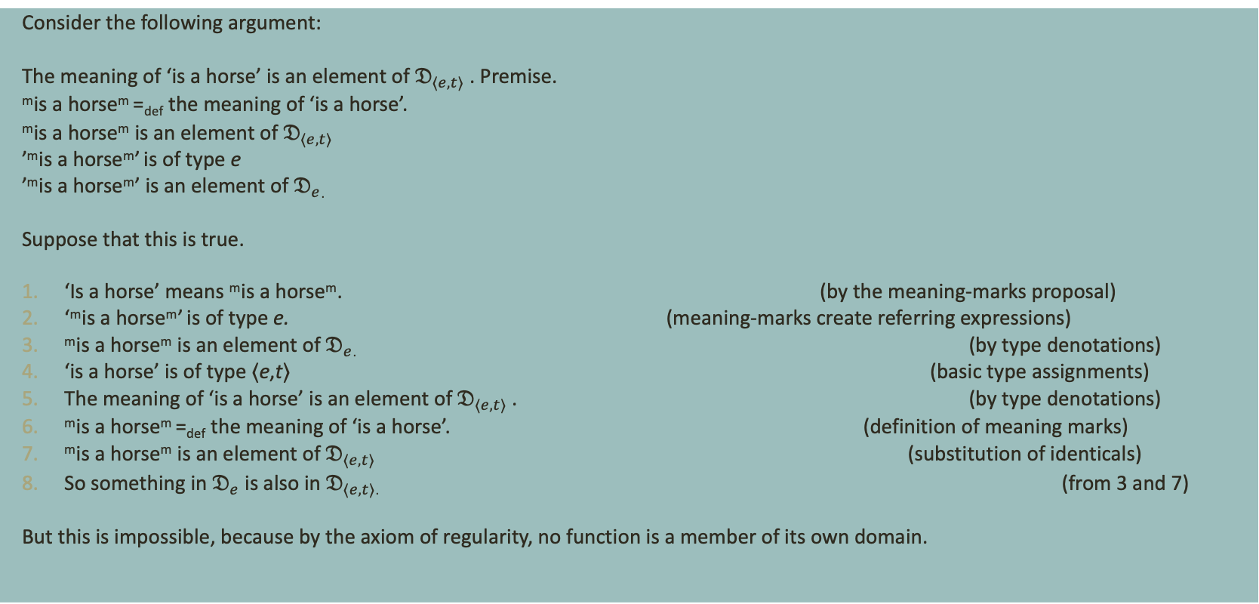
Second problem for the meaning-mark view: the concept horse.
Consider the following argument:
The meaning of ‘is a horse’ is an element of $𝔇_{⟨e,t⟩}$ . Premise.
^{m}is a horse^{m} =_{def} the meaning of ‘is a horse’.
^{m}is a horse^{m} is an element of $𝔇_{⟨e,t⟩}$
’^{m}is a horse^{m}’ is of type e
’^{m}is a horse^{m}’ is an element of $𝔇_{e}$.
Suppose that this is true.
‘Is a horse’ means ^{m}is a horse^{m}. (by the meaning-marks proposal)
‘^{m}is a horse^{m}’ is of type e. (meaning-marks create referring expressions)
^{m}is a horse^{m} is an element of $𝔇_{e}$. (by type denotations)
‘is a horse’ is of type ⟨e,t⟩ (basic type assignments)
The meaning of ‘is a horse’ is an element of $𝔇_{⟨e,t⟩}$ . (by type denotations)
^{m}is a horse^{m} =_{def} the meaning of ‘is a horse’. (definition of meaning marks)
^{m}is a horse^{m} is an element of $𝔇_{⟨e,t⟩}$ (substitution of identicals)
So something in $𝔇_{e}$ is also in $𝔇_{⟨e,t⟩}$. (from 3 and 7)
But this is impossible, because by the axiom of regularity, no function is a member of its own domain.

Slide 52
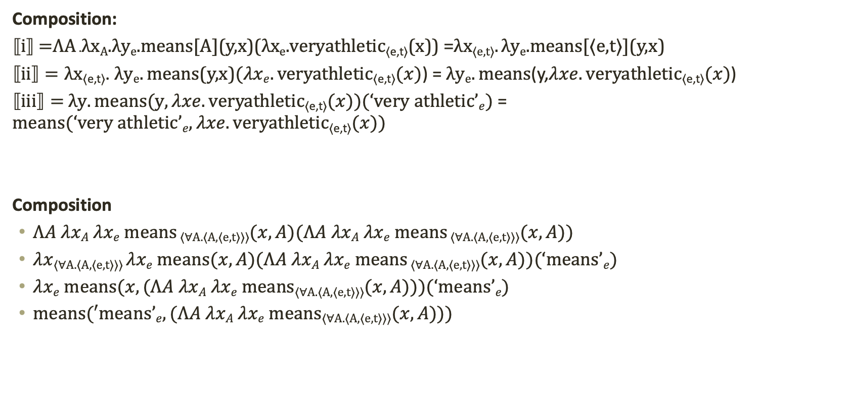
Composition:
$⟦i⟧$ $=$ΛA .λx_{A}.λy_{e}.means[A](y,x)(λx_{e}.veryathletic_{⟨e,t⟩}(x)) =λx_{⟨e,t⟩}. λy_{e}.means[⟨e,t⟩](y,x)
$⟦ii⟧=λx\text{⟨}\text{e}\text{,}\text{t}\text{⟩}\text{.} λye.means$(y,x)$(λxe.veryathletic\text{⟨}\text{e}\text{,}\text{t}\text{⟩}(x)\text{)}$ = $λye.means\text{(}\text{y}\text{,}λxe.veryathletic\text{⟨}\text{e}\text{,}\text{t}\text{⟩}(x)\text{)}$
$⟦iii⟧=$ $λy.means(y,λxe.veryathletic\text{⟨}\text{e}\text{,}\text{t}\text{⟩}(x)\text{)(}‘very athletic’e)$ = $means(‘very athletic’e,λxe.veryathletic\text{⟨}\text{e}\text{,}\text{t}\text{⟩}(x))$
Composition
$ΛA λxA λxe means$_{⟨∀A.⟨A,⟨e,t⟩⟩⟩}$(x,A)(ΛA λxA λxe means$_{⟨∀A.⟨A,⟨e,t⟩⟩⟩}$(x,A))$
$λx$_{⟨∀A.⟨A,⟨e,t⟩⟩⟩} $λxe means(x,A)(ΛA λxA λxe means$_{⟨∀A.⟨A,⟨e,t⟩⟩⟩}$(x,A))(‘means’e)$
$λxe means(x,(ΛA λxA λxe means$_{⟨∀A.⟨A,⟨e,t⟩⟩⟩}$(x,A)))(‘means’e)$
$means(′means’e,(ΛA λxA λxe means$_{⟨∀A.⟨A,⟨e,t⟩⟩⟩}$(x,A)))$

